Slide 1
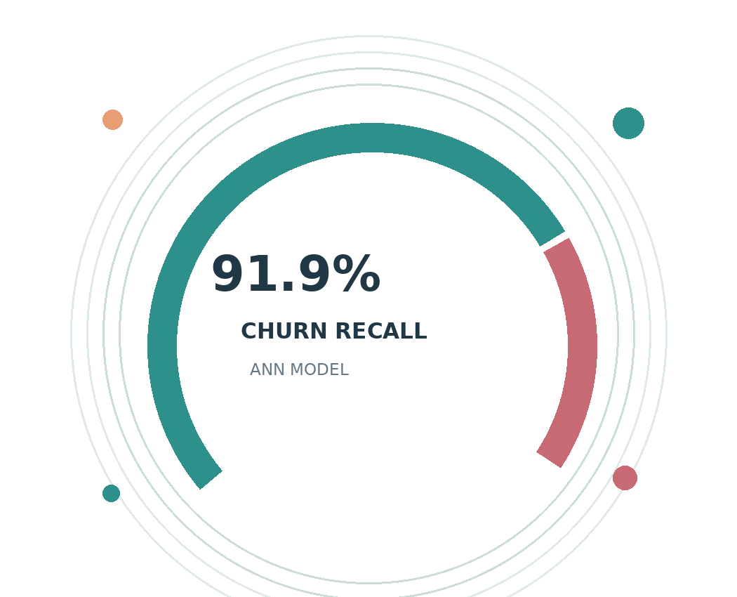
STAGE 2 / RESULTS PRESENTATION
Predicting
Customer Churn
with Artificial Neural Networks
Data preparation · clustering · model comparison · business decisions
6,741
03
1,349
CUSTOMERS
MODELS
TEST RECORDS
Sateesh Stage_3_Deliverables · 25 October 2026
Notes:
This presentation reviews a customer churn prediction project based on cleaned and clustered customer datasets. The study tests whether artificial neural networks can identify customers at risk of leaving. Alongside the ANN, logistic regression and random forest establish useful comparison points. The analysis uses independent testing and highlights a central operational challenge: identifying departures while avoiding costly retention outreach campaigns.

Slide 2
PROJECT FRAMING
Objective and approach
STUDY OBJECTIVE AND MODEL DESIGN
FROM CUSTOMER DATA TO ACTION
• Predict churn using 12 encoded customer indicators.
• Distinguish churned (1) from retained (0) customers.
• Analyse all 6,741 records in the supplied dataset.
• Estimate individual churn probabilities with an ANN.
• Add four train-fitted cluster indicators as features.
• Compare ANN, logistic regression and random forest.
• Prioritise early warnings while assessing alert costs.
01 12 CUSTOMER FEATURES
↓
02 4 SEGMENT FLAGS
↓
03 3 CLASSIFIERS
↓
04 RISK SCORE + ACTION
Target population: 26.6% churn
Sources: Goreja (n.d.); Customer Churn ANN Project (2026).
02
Notes:
Our objective is to estimate churn risk from twelve customer indicators, including service choices, charges and contract characteristics. We examine 6,741 customers and use cluster indicators to enrich the predictors. The supervised ANN is compared with logistic regression and random forest. The intended output is a customer risk score that supports earlier, more targeted retention decisions in practice at scale.

Slide 3
METHODOLOGY OVERVIEW
Training, validation and test design
DATA AND EVALUATION CONTROLS
DATA SPLIT · STRATIFIED
• Use 6,741 records with a 26.6% churn rate.
• Train on 4,313 customers (64% of the dataset).
• Validate on 1,079 customers (16% of the dataset).
• Test on 1,349 unseen customers (20% of the data).
• Fit scaling and K-Means (k = 4) on training data.
• Train ANN, logistic regression and random forest.
• Select by validation PR-AUC and tune using F2.
TRAIN
4,313 | 64%
VALIDATION
1,079 | 16%
TEST
1,349 | 20%
FINAL TEST: no model selection or retuning
Sources: Goreja (n.d.); scikit-learn (n.d.); Project (2026).
03
Notes:
The methodology separates 4,313 training records, 1,079 validation records and 1,349 held out test records. These correspond approximately to sixty four, sixteen and twenty percent of the data. Fresh scaling and clustering use the training partition only. Three models are fitted, with validation precision recall AUC selecting the candidate and validation F2 determining the classification threshold without inspecting test scores.

Slide 4
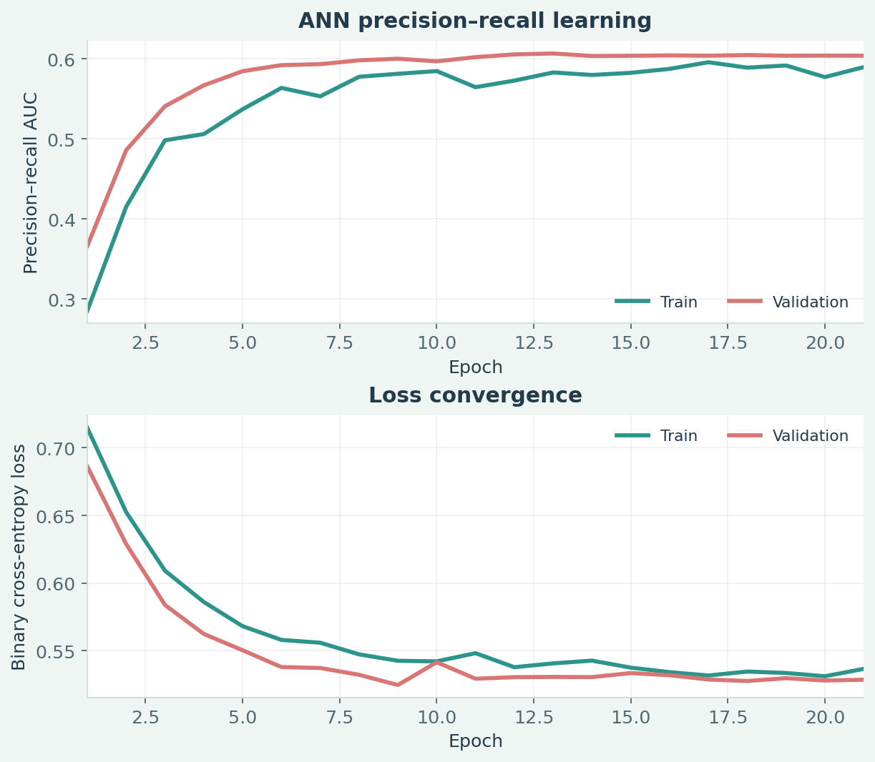
ANN TRAINING
Neural network training and validation
TRAINING CHOICES AND RESULTS
LEARNING CURVES · TRAIN VERSUS VALIDATION
• Model inputs: 12 attributes and four cluster flags.
• Train for up to 45 epochs with early stopping.
• Training finished after 21 epochs (Keras, n.d.).
• Monitor loss, accuracy, ROC-AUC and PR-AUC.
• ANN validation PR-AUC reached 0.607.
• Logistic validation PR-AUC reached 0.604.
• Choose ANN on validation; set its threshold to 0.298.
Observed epochs: 21 • Early stopping enabled
Sources: Keras (n.d.); Customer Churn ANN Project (2026).
04
Notes:
The neural network combines twelve original predictors with four newly fitted customer segment flags. Early stopping ends training after twenty one epochs from a maximum allowance of forty five. Learning curves track loss and performance during training and validation. The ANN narrowly leads validation precision recall AUC and is therefore selected before examining independent test results or adjusting test outcomes.

Slide 5
MODEL EVALUATION
Measurement scores: three-model comparison
HELD-OUT TEST RESULTS • VALIDATION-TUNED THRESHOLDS
MODEL
ROC-AUC
PR-AUC
F1
RECALL
PRECISION
ACCURACY
Logistic regression
0.817
0.596
0.561
92.7%
40.2%
61.5%
Random forest
0.789
0.542
0.530
90.2%
37.5%
57.5%
ANN ★ SELECTED
0.810
0.587
0.557
91.9%
40.0%
61.2%
PERFORMANCE INTERPRETATION
• Logistic regression has the strongest test ROC-AUC and PR-AUC.
• ANN ranks second on these threshold-independent AUC measures.
• Logistic regression achieves the highest recall: 92.7%.
• ANN captures 91.9% of churners at a 0.298 threshold.
• F1 scores remain modest because precision is near 40%.
• Threshold selection raises recall but lowers overall accuracy.
• ANN was selected by validation PR-AUC, not the test results.
Source: Customer Churn ANN Project (2026), held-out metrics.json.
05
Notes:
This table reports held out test performance for every classifier. Logistic regression leads test ROC AUC and precision recall AUC, while the ANN remains close. Recall exceeds ninety percent for all models after validation threshold tuning. However, precision stays below fifty percent and F1 remains modest. The selected ANN reflects validation results, not retrospective test selection, for unbiased comparisons overall.

Slide 6
DISCUSSION OF KEY FINDINGS
High recall comes with a false-alert trade-off
MEANING OF THE TEST SCORES
ANN CONFUSION MATRIX · TEST SET
• The ANN finds 329 of 358 real churners in testing.
• Only 29 churners are missed: recall is 91.9%.
• It flags 494 retained customers incorrectly.
• Churn precision is 40.0%; alerts need prioritisation.
• Test ROC-AUC is 0.810 and PR-AUC is 0.587.
• Logistic regression is slightly stronger on test AUC.
• Evaluate outreach costs and upstream scaling leakage.
Predicted retained Predicted churn
497
494
TRUE NEGATIVE
FALSE POSITIVE
29
329
FALSE NEGATIVE
TRUE POSITIVE
329 found / 358 total churners
Recall-first strategy ≠ highest accuracy
Sources: Project (2026), metrics.json; scikit-learn (n.d.).
06
Notes:
The confusion matrix explains the business implications of the selected neural network. It finds 329 actual churners, misses 29, and wrongly flags 494 retained customers. Consequently, high recall improves potential customer coverage but increases retention campaign costs. Logistic regression has somewhat better test ranking performance. Deployment therefore requires calibrated outreach economics and further upstream data preparation checks under real conditions.

Slide 7
SOURCE MATERIAL
References and project provenance
PRIMARY DATA + OUTPUTS
Goreja, A. (n.d.) Stage_2_Deliverables [GitHub repository].
https://github.com/aadeshgoreja/Stage_2_Deliverables
Customer Churn ANN Project (2026) Results package:
metrics.json; model_scores.csv; ann_training_history.json.
Source dataset: cleaned_full_dataset.csv (6,741 rows).
All numerical charts and comparative scores are drawn from the submitted project outputs.
Project source repository and official Keras / scikit-learn documentation.
07
Notes:
The repository is the source of the encoded customer records and published cluster information. The project outputs provide measured performance, confusion matrices and training records. Keras documents early stopping and saved models, while scikit learn describes sampling and performance evaluation. These sources distinguish observed project results from technical methods and help users reproduce or scrutinise the analysis throughout the report.

